Slide 1

OBJECT ORIENTED PROGRAMMING WITH C++
Kusuma K V
Department of Computer Science & Engineering

Slide 2

OBJECT ORIENTED PROGRAMMING WITH C++
UNIT 4
Kusuma K V
Department of Computer Science & Engineering

Slide 3
OBJECT ORIENTED PROGRAMMING WITH C++
Unit 4
Unit 4: Virtual Functions and Polymorphism, Function Overriding, VTBL and VPTR, Pure Virtual Functions and Abstract Base Class, Virtual Destructors, Multiple Inheritance, Virtual Base Classes, Type Casting, Run Time Type Identification (RTTI), Composition, Class Templates, Exception Handling

Slide 4
OBJECT ORIENTED PROGRAMMING WITH C++
Casting: Basic Rules
Casting is performed when a value (variable) of one type is used in place of
some other type
int i = 3;
double d = 2.5;
double result = d / i; // i is cast to double and used
Casting can be implicit or explicit
int i = 3;
double d = 2.5;
double *p = &d;
d = i; // implicit
i = d; // implicit -- // warning: '=' : conversion from 'double' to 'int', possible loss of data
i = (int)d; // explicit
i = p; // error '=' : cannot convert from 'double *' to 'int'
i = (int)p; // explicit

Slide 5
OBJECT ORIENTED PROGRAMMING WITH C++
Casting: Basic Rules
(Implicit) Casting between unrelated classes is not permitted
class A { int i; };
class B { double d; };
A a; B b;
A *p = &a; B *q = &b;
a = b; // error: no match for 'operator=' (operand types are 'A' and 'B')
// which takes a right-hand operand of type 'main::B'
a = (A)b; // error: 'type cast' : cannot convert from 'main::B' to 'main::A'
b = a; // error: no match for 'operator=' (operand types are 'B' and 'A')
// which takes a right-hand operand of type 'main::A'
b = (B)a; // error: 'type cast' : cannot convert from 'main::A' to 'main::B'
p = q; // error: cannot convert 'B*' to 'A*' in assignment
q = p; // error: cannot convert 'A*' to 'B*' in assignment
p = (A*)&b; // Forced -- Okay
q = (B*)&a; // Forced -- Okay

Slide 6
OBJECT ORIENTED PROGRAMMING WITH C++
Casting on a Hierarchy
Casting on a hierarchy is permitted in a limited sense
Upcasting is safe
Base class pointer/reference referring to derived class object
Downcasting is an error, if done explicitly then risky
Derived class pointer/reference referring to base class object

Slide 7
OBJECT ORIENTED PROGRAMMING WITH C++
Type of an Object
The static type of the object is the type declared for the object while writing the code
Compiler sees static type
The dynamic type of the object is determined by the type of the object to which it currently refers
Compiler does not see dynamic type
class A { };
class B : public A { };
int main() {
A *p;
p = new B; // Static type of p = A
// Dynamic type of p = B
}

Slide 8
OBJECT ORIENTED PROGRAMMING WITH C++
Static and Dynamic Binding
Static binding (early binding): When a function invocation binds to the function definition based on the static type of objects
This is done at compile-time
Normal function calls, overloaded function calls, and overloaded operators are examples of static binding
Dynamic binding (late binding): When a function invocation binds to the function definition based on the dynamic type of objects
This is done at run-time
Function pointers, Virtual functions are examples of late binding

Slide 9
OBJECT ORIENTED PROGRAMMING WITH C++
Virtual function
Virtual function is a member function that defines type-specific behaviour. Calls to a virtual made through a reference or pointer are resolved at run time, based on the type of the object to which the reference or pointer is bound (Dynamic Polymorphism)
A base class specifies that a member function should be dynamically bound by preceding its declaration with the keyword virtual.
Any non static member function, other than a constructor, may be virtual
The virtual keyword appears only on the declaration inside the class and may not be used on a function definition that appears outside the class body
A function that is declared as virtual in the base class is implicitly virtual in the derived classes as well
Because the decision as to which version to run depends on the type of the argument, that decision can’t be made until run time. Therefore, dynamic binding is sometimes known as run-time binding

Slide 10
OBJECT ORIENTED PROGRAMMING WITH C++
Virtual function
Dynamic binding is possible only for pointer and reference data types and for member functions that are declared as virtual in the base class
These are called Virtual Functions
If a member function is declared as virtual, it can be overridden in the derived class
If a member function is not virtual and it is re-defined in the derived class then the latter definition hides the former one
Any class containing a virtual member function by definition or by inheritance is called a Polymorphic Type
A hierarchy may be polymorphic or non-polymorphic
A non-polymorphic hierarchy has little value

Slide 11
OBJECT ORIENTED PROGRAMMING WITH C++
Virtual function
#include <iostream>
using namespace std;
class A { public:
void f() { cout << "A::f()" << endl; }
virtual void g() { cout << "A::g()" << endl; }
void h() { cout << "A::h()" << endl; }
};
class B : public A { public:
void f() { cout << "B::f()" << endl; }
void g() { cout << "B::g()" << endl; }
virtual void h() { cout << "B::h()" << endl; }
};
class C : public B { public:
void f() { cout << "C::f()" << endl; }
void g() { cout << "C::g()" << endl; }
void h() { cout << "C::h()" << endl; }
};
int main() {
B *q = new C;
A *p = q;
p->f();
p->g();
p->h();
q->f();
q->g();
q->h();
return 0;
}

Slide 12
OBJECT ORIENTED PROGRAMMING WITH C++
Virtual function
#include <iostream>
using namespace std;
class A { public:
void f() { cout << "A::f()" << endl; }
virtual void g() { cout << "A::g()" << endl; }
void h() { cout << "A::h()" << endl; }
};
class B : public A { public:
void f() { cout << "B::f()" << endl; }
void g() { cout << "B::g()" << endl; }
virtual void h() { cout << "B::h()" << endl; }
};
class C : public B { public:
void f() { cout << "C::f()" << endl; }
void g() { cout << "C::g()" << endl; }
void h() { cout << "C::h()" << endl; }
};
int main() {
B *q = new C;
A *p = q;
p->f();
p->g();
p->h();
q->f();
q->g();
q->h();
return 0;
}
Solution:
A::f()
C::g()
A::h()
B::f()
C::g()
C::h()

Slide 13
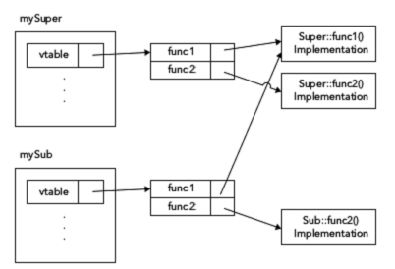
OBJECT ORIENTED PROGRAMMING WITH C++
Virtual function
class Super
{
public:
virtual void func1() {}
virtual void func2() {}
void nonVirtualFunc() {}
};
class Sub : public Super
{
public:
virtual void func2() override {}
void nonVirtualFunc() {}
};
For this example, assume that you have the following two instances:
Super mySuper;
Sub mySub;

Slide 14
OBJECT ORIENTED PROGRAMMING WITH C++
using Construct - Avoid Method Hiding
#include<iostream>
using namespace std;
class A { public:
void f() {}
};
class B : public A {public:
// To overload, rather than hide the base class function f()
// is introduced into the scope of B with a using declaration
using A::f;
void f(int) { }
};
int main() {
B b; // function calls resolved at compile time
b.f(3); // B::f(int)
b.f(); // A::f()
}
Object b of derived class linked to with inherited base class function f() and the overloaded version
defined by the derived class f(int), based on the input parameters - function calls resolved at compile time

Slide 15
OBJECT ORIENTED PROGRAMMING WITH C++
Pure Virtual function and Abstract Base Class
Pure virtual function is a virtual function declared in the class using = 0 just before the semicolon
A pure virtual function need not be (but may be) defined. Classes with pure virtuals are abstract classes
The = 0 may appear only on the declaration of a virtual function in the class. It is worth noting that we can provide a definition for a pure virtual. However, the function body must be defined outside the class. That is, we cannot provide a function body inside the class for a function that is = 0
A class containing (or inheriting without overridding) a pure virtual function is an abstract base class
An abstract base class defines an interface for subsequent classes to override. If a derived class does not define its own version of an inherited pure virtual, then the derived class is abstract as well
We cannot create objects of a type that is an abstract class
Programming example

Slide 16
OBJECT ORIENTED PROGRAMMING WITH C++
Virtual Destructor
#include<iostream>
using namespace std;
class Base
{
public:
Base() { }
~Base() {cout<<"dtor"<<endl;}
};
class Derived : public Base
{
public:
Derived() { mString = new char[30]; }
~Derived() { cout<<"ddtor"<<endl;delete [] mString; }
private:
char* mString;
};
int main()
{
Base* ptr = new Derived();
delete ptr; // ~Base is called, but not ~ Derived because the destructor is not virtual!
return 0;
}

Slide 17
OBJECT ORIENTED PROGRAMMING WITH C++
Virtual Destructor
#include<iostream>
using namespace std;
class Base
{
public:
Base() { }
virtual ~Base() {cout<<"dtor"<<endl;}
};
class Derived : public Base
{
public:
Derived() { mString = new char[30]; }
~Derived() { cout<<"ddtor"<<endl;delete [] mString; }
private:
char* mString;
};
int main()
{
Base* ptr = new Derived();
delete ptr; // ~Derived is called because the destructor is virtual!
return 0;
}

Slide 18
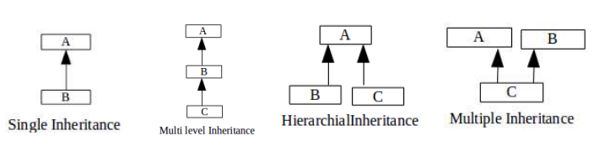
OBJECT ORIENTED PROGRAMMING WITH C++
Types of Inheritance
Single level inheritance: One derived class inherits from one base class
Multi level inheritance: A class inherits from a derived class. This happens in more than one level
Hierarchial inheritance: A single class serves as a base class for more than one derived class
Multiple inheritance: A class derives from more than one base class
Programming example for each type

Slide 19
OBJECT ORIENTED PROGRAMMING WITH C++
Multiple Inheritance
Multiple Inheritance: A class derives from more than one base class
Eg: TA is a Teacher, TA is a Student. Therefore, TA inherits from both Teacher and Student class
class Student{ }; // Base Class = Student
class Teacher{ }; // Base Class = Teacher
class TA: public Student, public Teacher{ }; // Derived Class = TA
TA inherits properties and operations of both Student as well as Teacher
A
Student
Teacher
B
C
TA

Slide 20
OBJECT ORIENTED PROGRAMMING WITH C++
Multiple Inheritance
If all the base classes are to be derived in public, then in the derivation list, all base classes should be preceded by the keyword public
Otherwise, the class not preceded with the access specifier will be derived in private as default inheritance for class is private
Eg: class Base1{ };
class Base2{ };
class Derived : public Base1,Base2{ };
In the above Eg: Base1 is derived in public whereas Base2 in private

Slide 21
OBJECT ORIENTED PROGRAMMING WITH C++
Multiple Inheritance in C++ : Semantics
class Base1{ };
class Base2{ };
class Derived : public Base1,public Base2{ };
Use keyword public(private, protected) after class name to denote inheritance
Name of the Base class follow the keyword
There may be more than two base classes
public, private and protected inheritance may be mixed

Slide 22
OBJECT ORIENTED PROGRAMMING WITH C++
Multiple Inheritance in C++ : Semantics
Derived ISA Base1, Base2
Data Members
Derived class inherits all data members of all Base classes
Derived class may add data members of its own
Member Functions
Derived class inherits all member functions of all Base classes
Derived class may override a member function of any Base class by redefining it with the same signature
Derived class may overload a member function of any Base class by redefining it with the same name; but different signature

Slide 23
OBJECT ORIENTED PROGRAMMING WITH C++
Multiple Inheritance in C++ : Semantics
Access Specification
Derived class cannot access private members of any Base class
Derived class can access protected and public members of any Base class
Construction-Destruction
A constructor of the Derived class must first call constructors of the Base classes to construct the Base class instances of the Derived class – Base class constructors are called in listing order
The destructor of the Derived class must call the destructors of the Base classes to destruct the Base class instances of the Derived class

Slide 24
OBJECT ORIENTED PROGRAMMING WITH C++
Multiple Inheritance in C++ : Data members and Object Layout
Derived ISA Base1, Base2
Data Members
Derived class inherits all data members of all Base classes
Derived class may add data members of its own
Object Layout
Derived class layout contains instances of each Base class
Further, Derived class layout will have data members of its own
C++ does not guarantee the relative position of the Base class instances and Derived class members

Slide 25
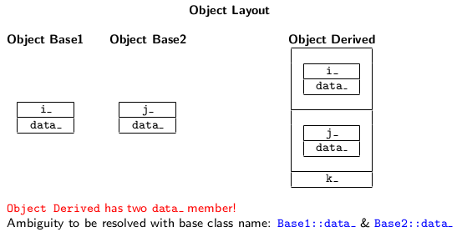
OBJECT ORIENTED PROGRAMMING WITH C++
Multiple Inheritance in C++ : Data members and Object Layout
class Base1 {
protected:
int i_;
int data_;
public: // ...
};
class Base2 {
protected:
int j_;
int data_;
public: // ...
};
class Derived : public Base1, public Base2 {
int k_;
public: // ...
};

Slide 26
OBJECT ORIENTED PROGRAMMING WITH C++
Multiple Inheritance in C++ : Member functions Overrides and Overloads
Derived ISA Base1, Base2
Member Functions
Derived class inherits all member functions of all Base classes
Derived class may override a member function of any Base class by redefining it with the same signature
Derived class may overload a member function of any Base class by redefining it with the same name; but different signature
Static Member Functions
Derived class does not inherit the static member functions of any Base class
Friend Functions
Derived class does not inherit the friend functions of any Base class

Slide 27
OBJECT ORIENTED PROGRAMMING WITH C++
Multiple Inheritance in C++
An object of a class defined by multiple inheritance contains not only the data members defined in the derived class, but also data members of all the base classes
Also, w.r.t such an object, it is possible to call the member functions of not only the derived class, but also the member functions of all the base classes
multipleInherit.cpp
memberFn_ctor_dtor.cpp

Slide 28
OBJECT ORIENTED PROGRAMMING WITH C++
Ambiguities in Multiple Inheritance
Identical members in more than one Base class
mulInherit_ambiguity1.cpp
mulInherit_ambiguity2_Override.cpp
mulInherit_ambiguity2_ScopeResoln.cpp
Diamond Shaped Inheritance
diamond.cpp
diamond1.cpp
diamondInheritance.cpp
The virtual specifier states a willingness to share a single instance of the named base class within a subsequently derived class. There are no special constraints on a class used as a virtual base class
Virtual derivation affects the classes that subsequently derive from a class with a virtual base; it doesn’t affect the derived class itself
Person
Student
Teacher
TA

Slide 29
OBJECT ORIENTED PROGRAMMING WITH C++
Type Casting
A cast operator takes an expression of source type (implicit from the expression) and convert it to an expression of target type (explicit in the operator) following the semantics of the operator
operator <type> (value whose type is to be converted)
C++ Style cast operators
const_cast
dynamic_cast
static_cast
reinterpret_cast

Slide 30
OBJECT ORIENTED PROGRAMMING WITH C++
const_cast
const_cast operator is used to take away the constness of a variable
//constCast1.cpp
#include <iostream>
using namespace std;
void print(char * str) { cout <<str<<endl; }
int main()
{
const char * c = "sample text";
// print(c); //error: ’void print(char *)’: cannot convert argument1 from ’const char *’ to ’char *’
print(const_cast<char *>(c)); //Removes the constness associated with 'c' and passes to print()
return 0;
}

Slide 31
OBJECT ORIENTED PROGRAMMING WITH C++
const_cast
int main()
{
const A a(1);
cout<<a.get()<<endl;
//a.set(5); // error: ’void A::set(int)’: cannot convert ’this’ pointer from ’const A’ to ’A &’
const_cast<A&>(a).set(5);
//const_cast<A>(a).set(5); // error: ’const_cast’: cannot convert from ’const A’ to ’A’ i.e., cannot strip the constness of the object, so as given in the above line create a non const reference to the object and pass it to the function
cout<<a.get()<<endl;
return 0;
}
//constCast2.cpp
#include <iostream>
using namespace std;
class A
{
int i;
public:
A(int i1) : i(i1) {}
int get() const { return i; }
void set(int i1) { i = i1; }
};

Slide 32
OBJECT ORIENTED PROGRAMMING WITH C++
static_cast
static_cast can be used to perform explicit conversions that are supported directly by the language
For example, if you write an arithmetic expression in which you need to convert an int to a double in order to avoid integer division, use a static_cast
In this example, it’s enough to only static_cast i , because that makes one of the two operands a double , making sure C++ performs floating point division
int i = 3;
int j = 4;
double result = static_cast<double>(i) / j;

Slide 33
OBJECT ORIENTED PROGRAMMING WITH C++
static_cast
#include <iostream>
using namespace std;
// Built-in Types
int main() {
int i = 2;
double d = 3.7;
i=d; // implicit -- okay
i = static_cast<int>(d); // static_cast -- okay
i=(int)d; // C-style -- okay
cout<<i<<endl;
d = i; // implicit -- okay
d = static_cast<double>(i); // static_cast – okay
d = (double)i; // C-style -- okay
cout<<d<<endl;
return 0;
}

Slide 34
OBJECT ORIENTED PROGRAMMING WITH C++
static_cast
#include <iostream>
using namespace std;
// Class Hierarchy
class A { };
class B: public A { };
int main() {
A a;
B b;
// UPCAST
A *p = &b; // implicit -- okay
p = static_cast<A*>(&b); // static_cast -- okay
p = (A*)&b; // C-style – okay
// DOWNCAST
// B* q = &a; // implicit -- error
B* q = static_cast<B*>(&a); // static_cast -- okay: RISKY:
//Should use dynamic_cast
q = (B*)&a; // C-style -- okay
return 0;
}

Slide 35
OBJECT ORIENTED PROGRAMMING WITH C++
dynamic_cast, Run Time Type Information (RTTI)
To perform the cast safely with run-time type checking, use the dynamic_cast
dynamic_cast provides a run-time check on casts within an inheritance hierarchy
You can use it to cast pointers or references
dynamic_cast checks the run-time type information of the underlying object at run time. If the cast doesn’t make sense, dynamic_cast returns a null pointer (for the pointer version) or throws a std::bad_cast exception (for the reference version)
Its purpose is to ensure that the result of the type conversion points to a valid complete object of the destination pointer type
Note that the run-time type information is stored in the vtable of the object. Therefore, in order to use dynamic_cast , your classes must have at least one virtual method . If your classes don’t have a vtable, trying to use dynamic_cast will result in a compiler error. (source type is not polymorphic). However, if you are upcasting, compiler doesn’t show error.
dynamicCast.cpp

Slide 36
OBJECT ORIENTED PROGRAMMING WITH C++
dynamic_cast, Run Time Type Information (RTTI)
class Base { };
class Derived : public Base { };
int main()
{
Base b;
Derived d;
Base *pb = dynamic_cast<Base*>(&d); // LINE1
Derived *pd = dynamic_cast<Derived*>(&b); // LINE2
return 0;
}
LINE1 is okay because dynamic_cast is always successful when we cast a class to one of its base classes
LINE2 conversion has a compilation error:
error: cannot dynamic_cast '& b' (of type 'class Base*') to type 'class Derived*' (source type is not polymorphic).
It's because base-to-derived conversions are not allowed with dynamic_cast unless the base class is polymorphic

Slide 37
OBJECT ORIENTED PROGRAMMING WITH C++
reinterpret_cast
Note that you can perform the same casts down the inheritance hierarchy with a static_cast or reinterpret_cast. The difference with dynamic_cast is that it performs run-time (dynamic) type checking, while static_cast and reinterpret_cast will perform the casting even if they are erroneous
reinterpret_cast : reinterpret cast converts any pointer type to any other pointer type, even of unrelated classes

Slide 38
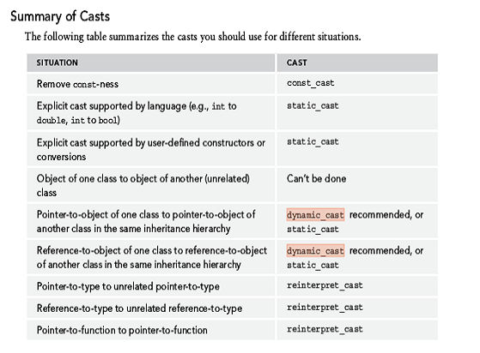
OBJECT ORIENTED PROGRAMMING WITH C++
Summary of casts

Slide 39
OBJECT ORIENTED PROGRAMMING WITH C++
Composition
Combining existing objects to create another, more complex object is called composition
When you compose a new object, you create complex behavior by delegating tasks to the internal objects
Composition is different from inheritance, which defines a new object by changing or refining the behavior of an old object
Inheritance is suitable only when classes are in a relationship in which subclass is a (kind of) superclass
For example: A Car is a Vehicle so the class Car has all the features of class Vehicle in addition to the features of its own class. However, we cannot always have an is a relationship between objects of different classes.
For example: A car is not a kind of engine. But a car has an engine (So use composition)
composition.cpp

Slide 40
OBJECT ORIENTED PROGRAMMING WITH C++
Class templates
Class templates define a class where the types of some of the variables, return types of methods, and/or parameters to the methods are specified as parameters
Class templates are useful primarily for containers, or data structures, that store objects. Classes like list, queue etc.
The data members and the methods are almost the same for list of numbers, list of objects. Yet, we need to define different classes
template < class T>
class classname
{
};
Here T will be specified when the object of the class is created
More than one generic data type can also be defined using a comma separated list of parameters
Programming example
template < class T1,class T2>
class classname
{
};

Slide 41
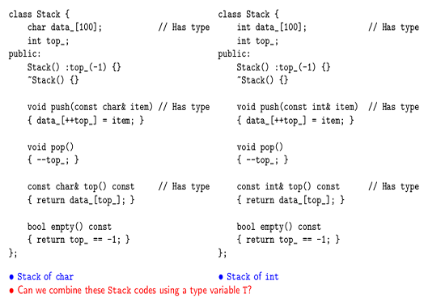
OBJECT ORIENTED PROGRAMMING WITH C++
Class templates

Slide 42
OBJECT ORIENTED PROGRAMMING WITH C++
Errors and Exceptions
No program exists in isolation; they all depend on external facilities such as interfaces with the operating system, networks and file systems, external code such as third-party libraries, and user input
Each of these areas can introduce situations which require responding to problems which may be encountered. These potential problems can be referred to with the general term exceptional situations. Even perfectly written programs encounter errors and exceptional situations
Thus, anyone who writes a computer program must include error-handling capabilities

Slide 43
OBJECT ORIENTED PROGRAMMING WITH C++
Errors and Exceptions
Some languages, such as C, do not include many specific language facilities for error handling
Programmers using these languages generally rely on return values from functions and other ad hoc approaches. Other languages, such as Java, enforce the use of a language feature called exceptions as an error-handling mechanism
C++ lies between these extremes. It provides language support for exceptions, but does not require their use. However, you can’t ignore exceptions entirely in C++ because a few basic facilities, such as memory allocation routines, use them

Slide 44
OBJECT ORIENTED PROGRAMMING WITH C++
Exceptions
What Are Exceptions, Anyway?
Exceptions are a mechanism for a piece of code to notify another piece of code of an “exceptional” situation or error condition without progressing through the normal code paths
The code that encounters the error throws the exception, and the code that handles the exception catches it. Exceptions do not follow the fundamental rule of step-by-step execution to which you are accustomed.
When a piece of code throws an exception, the program control immediately stops executing code step by step and transitions to the exception handler, which could be anywhere from the next line in the same function to several function calls up the stack

Slide 45
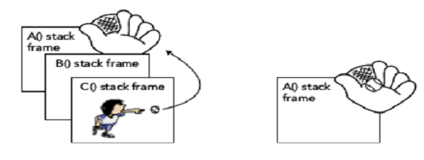
OBJECT ORIENTED PROGRAMMING WITH C++
Exception Handling
Sports Analogy
You can think of the code that throws an exception as an outfielder throwing a baseball back to the infield, where the nearest infielder (closest exception handler) catches it
Below figure (on left) shows a hypothetical stack of three function calls. Function A() has the exception handler. It calls function B() , which calls function C() , which throws the exception
Figure (on right) shows the handler catching the exception. The stack frames for C() and B() have been removed, leaving only A()

Slide 46
OBJECT ORIENTED PROGRAMMING WITH C++
Exception Handling
Why Exceptions in C++ Are a Good Thing
Run-time errors in programs are inevitable. Despite that fact, error handling in most C and C++ programs is messy and ad hoc. The de facto C error-handling standard, which was carried over into many C++ programs, uses integer function return codes and the errno macro to signify errors
Each thread has its own errno value. errno acts as a thread-local integer variable that functions can use to communicate errors back to calling functions
Unfortunately, the integer return codes and errno are used inconsistently
Some functions might choose to return 0 for success and –1 for an error. If they return –1, they also set errno to an error code
Other functions return 0 for success and nonzero for an error, with the actual return value specifying the error code. These functions do not use errno
Still others return 0 for failure instead of for success, presumably because 0 always evaluates to false in C and C++

Slide 47
OBJECT ORIENTED PROGRAMMING WITH C++
Exception Handling
These inconsistencies can cause problems because programmers encountering a new function often assume that its return codes are the same as other similar functions. That is not always true.
On Solaris 9, there are two different libraries of synchronization objects: the POSIX version and the Solaris version.
The function to initialize a semaphore in the POSIX version is called sem_init() , and the function to initialize a semaphore in the Solaris version is called sema_init() .
As if that weren’t confusing enough, the two functions handle error codes differently!
sem_init() returns –1 and sets errno on error
sema_init() returns the error code directly as a positive integer, and does not set errno .

Slide 48
OBJECT ORIENTED PROGRAMMING WITH C++
Exception Handling
Exceptions provide an easier, more consistent, and safer mechanism for error handling. There are several specific advantages of exceptions over the ad hoc approaches in C and C++.
When return codes are used as an error reporting mechanism, you might forget to check the return code and properly handle it either locally or by propagating it upwards. Exceptions cannot be forgotten or ignored: If your program fails to catch an exception, it will terminate.
When integer return codes are used, they generally do not contain sufficient information. You can use exceptions to pass as much information as you want from the code that finds the error to the code that handles it.
Exception handling can skip levels of the call stack. That is, a function can handle an error that occurred several function calls down the stack, without error-handling code in the intermediate functions. Return codes require each level of the call stack to clean up explicitly after the previous level.

Slide 49
OBJECT ORIENTED PROGRAMMING WITH C++
Exception Handling
Exception handling is not enforced in C++
For example, in Java a function that does not specify a list of possible exceptions that it can throw is not allowed to throw any exceptions
In C++, a function that does not specify a list of exceptions can throw any exception it wants!

Slide 50
OBJECT ORIENTED PROGRAMMING WITH C++
Exception Handling
Using exceptions consists of providing two parts in your program: a try/catch construct, to handle an exception, and a throw statement, that throws an exception. Both must be present in some form to make exceptions work.
The try/catch construct looks as follows:
try {
// ... code which may result in an exception being thrown
} catch (exception-type1 exception-name) {
// ... code which responds to the exception of type 1
} catch (exception-type2 exception-name) {
// ... code which responds to the exception of type 2
}
// ... remaining code

Slide 51
OBJECT ORIENTED PROGRAMMING WITH C++
Exception Handling
DivideByZero.cpp
tryCatchThrow.cpp
excepLevel.cpp
reThrow.cpp
multiCatch.cpp
matchAny.cpp
ctorDtorException.cpp

Slide 52
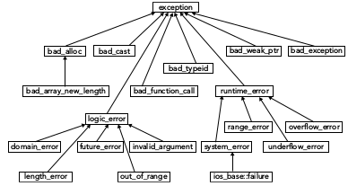
OBJECT ORIENTED PROGRAMMING WITH C++
Exception Handling
All Standard Library exceptions form a hierarchy. Each class in the hierarchy supports a what() method that returns a const char* string describing the exception. This is the string you provide in the constructor of the exception.

Slide 53
OBJECT ORIENTED PROGRAMMING WITH C++
All the Best ☺

Slide 54
THANK YOU
Kusuma K V
Department of Computer Science & Engineering
kusumakv@pes.edu

